Slide 1
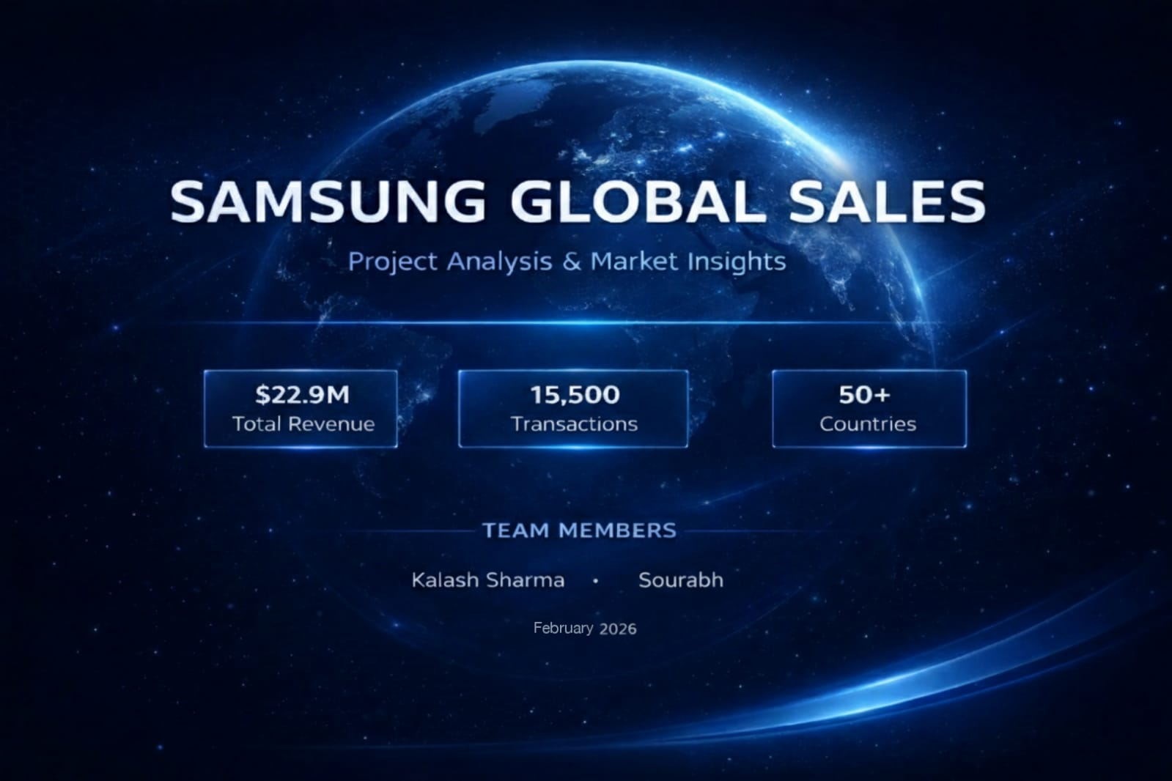

Slide 2


Slide 3
Project Overview: Samsung Global Sales Analysis (2021–2024)
1. Executive Summary : This project provides a comprehensive analysis of Samsung’s global sales performance over a four-year period. By synthesizing data from 52 countries and multiple product verticals, the study identifies key revenue drivers, technology adoption trends (5G), and operational efficiencies. The primary goal is to provide stakeholders with actionable intelligence to optimize regional marketing spend and improve product quality control.
2. Data Composition & Scope : The analysis is built upon a robust dataset containing over 36,000 units sold, segmented into several critical dimensions:
Temporal Scope: January 2021 to late 2024.
Geographic Reach: Global coverage across regions including Europe, Asia, North America, and South America.
Product Hierarchy: Major categories including Galaxy S Series, Smart TVs, Galaxy Tabs, and Accessories.
Sales Attributes: Unit pricing, discount structures, sales channels (Direct vs. Third-Party), and customer demographics.

Slide 4
Tool Used:
Excel : For Data Cleaning.
SQL : For Core Business Analytical Questions.
Power BI : For Professional Business Dashboard.

Slide 5
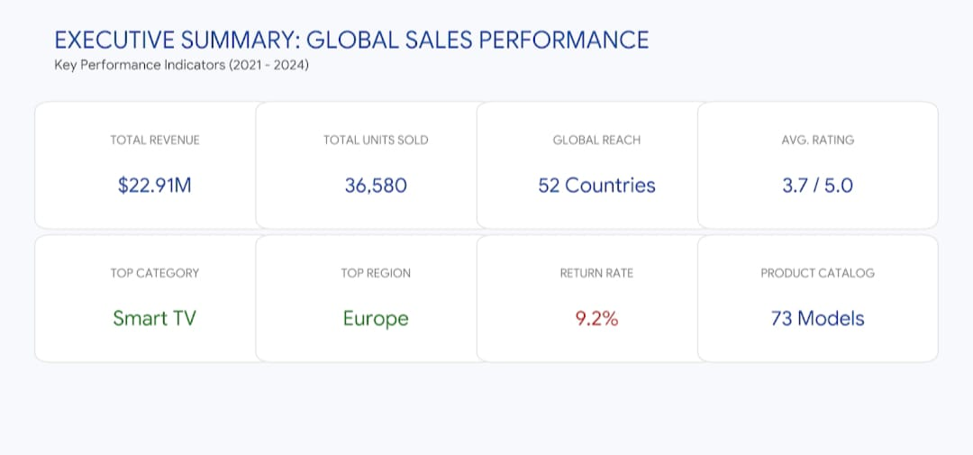

Slide 6
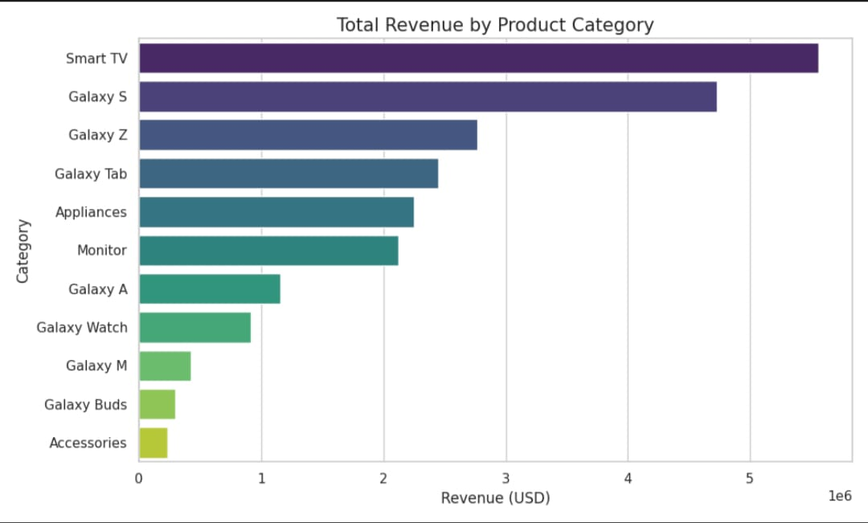
Some Pictorial Ways For Business Insights :

Slide 7
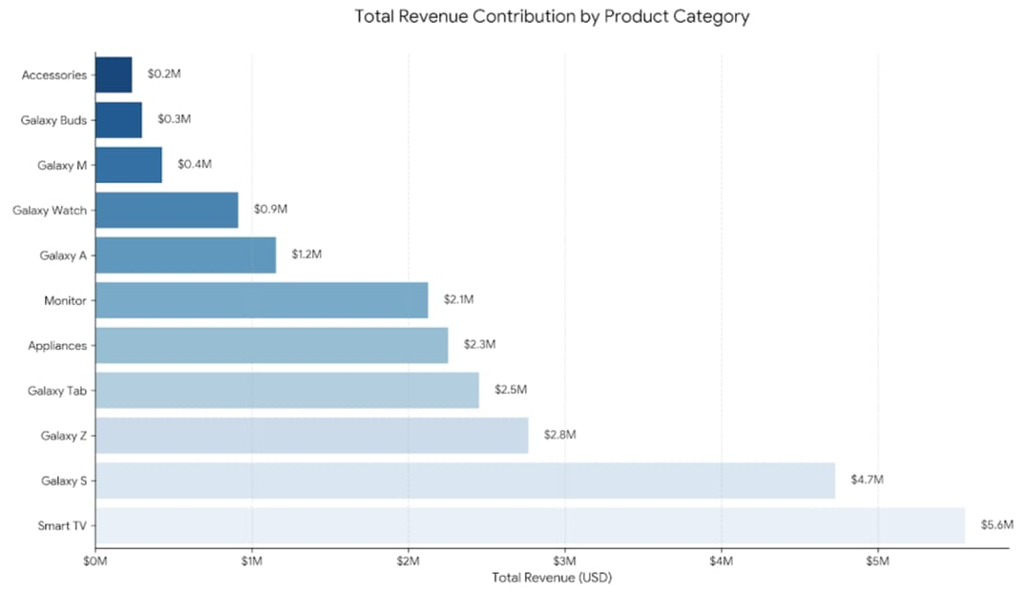

Slide 8
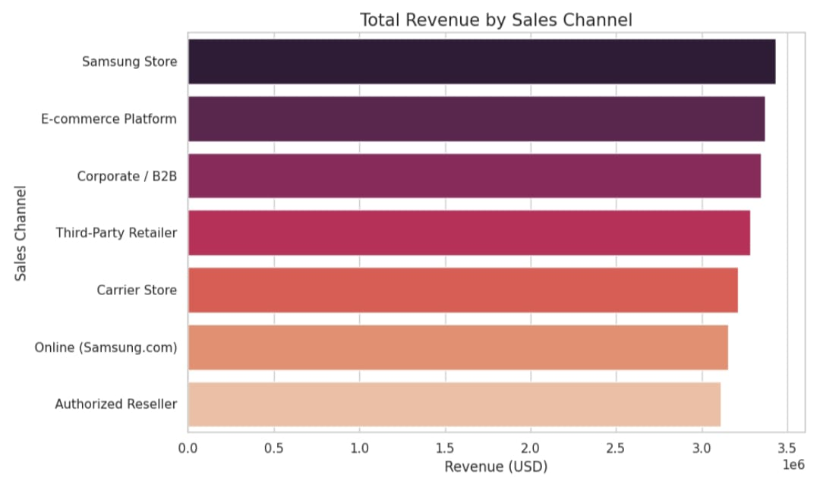

Slide 9
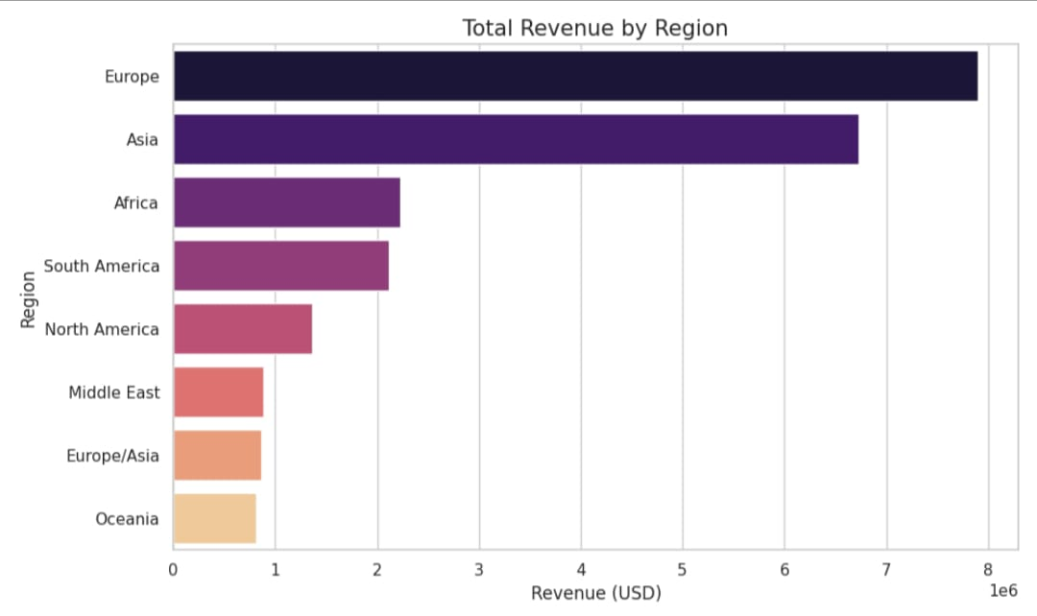

Slide 10
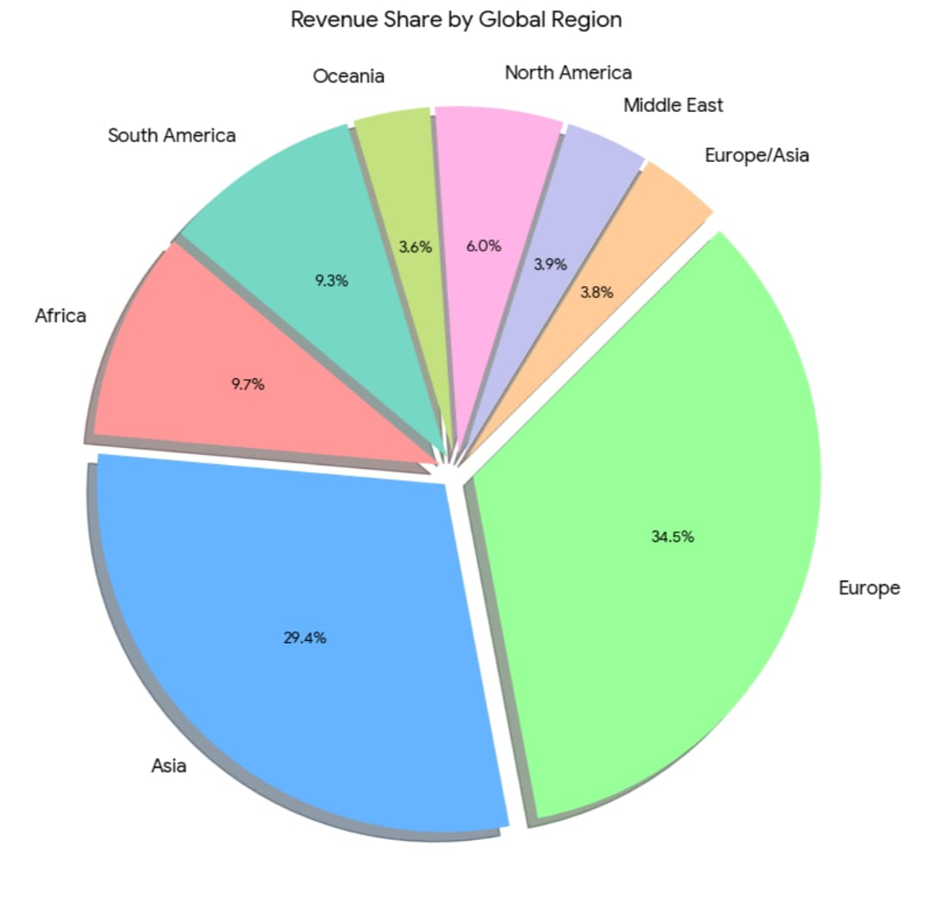

Slide 11
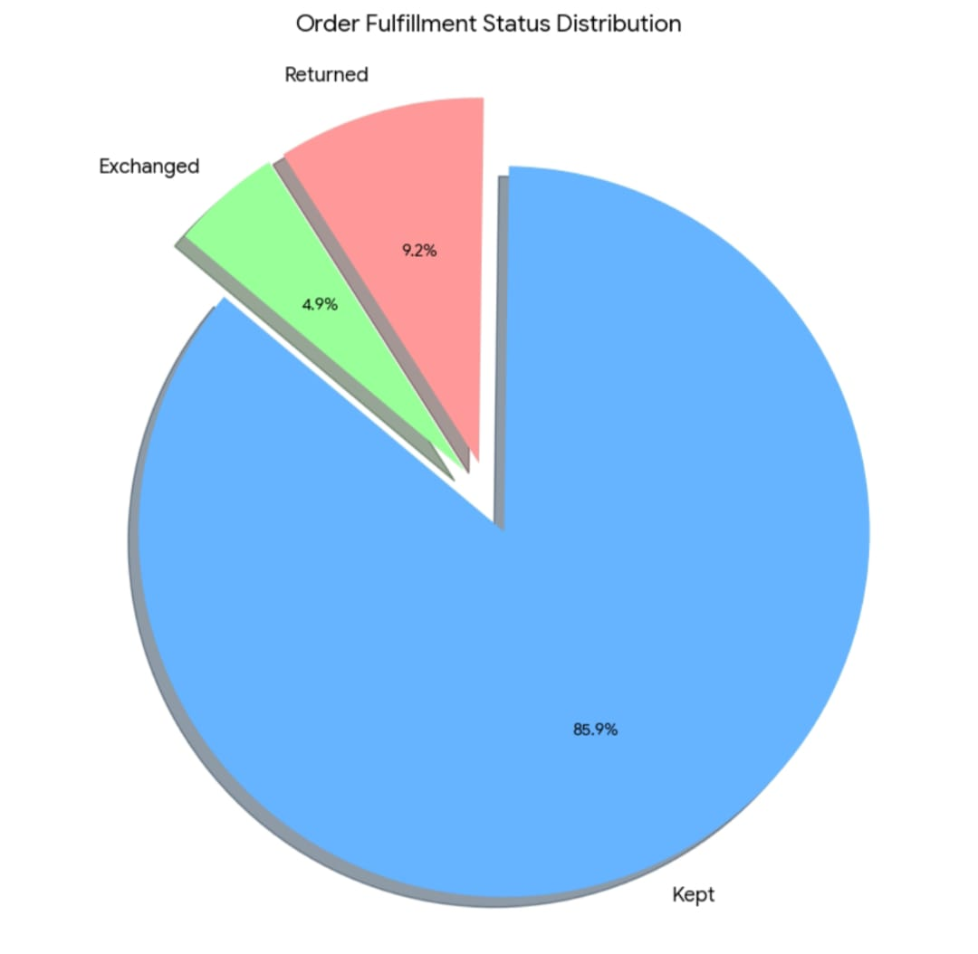

Slide 12
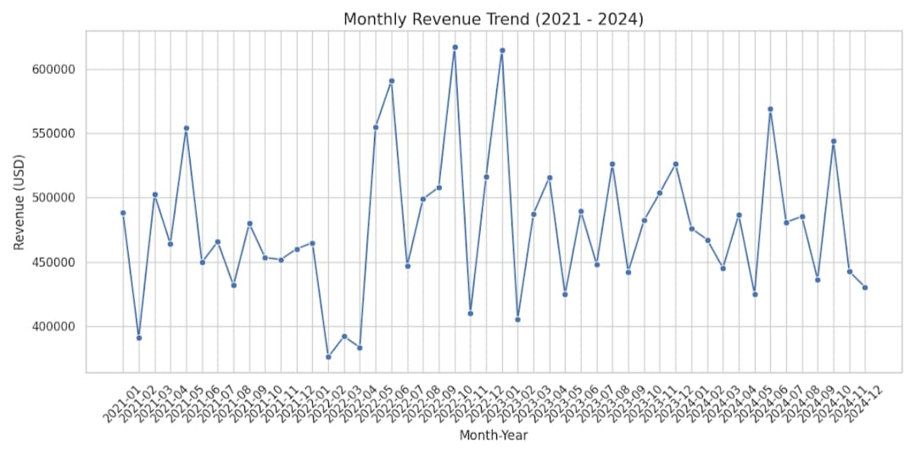

Slide 13
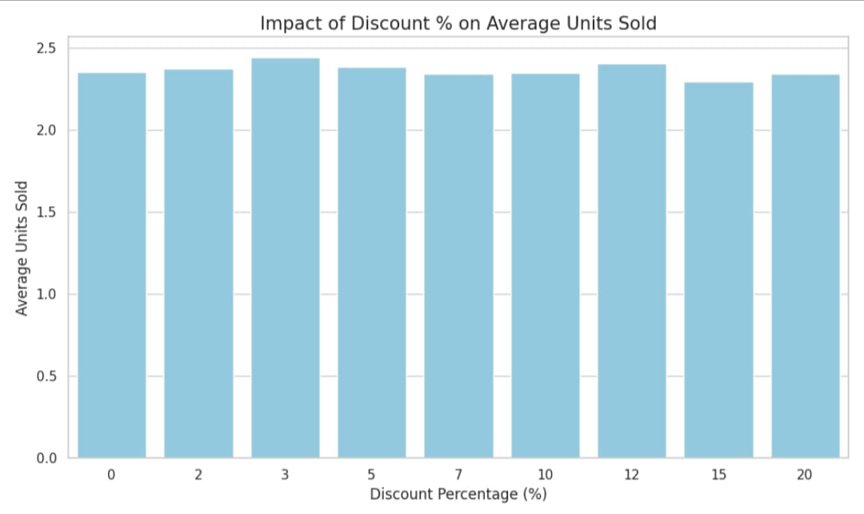

Slide 14
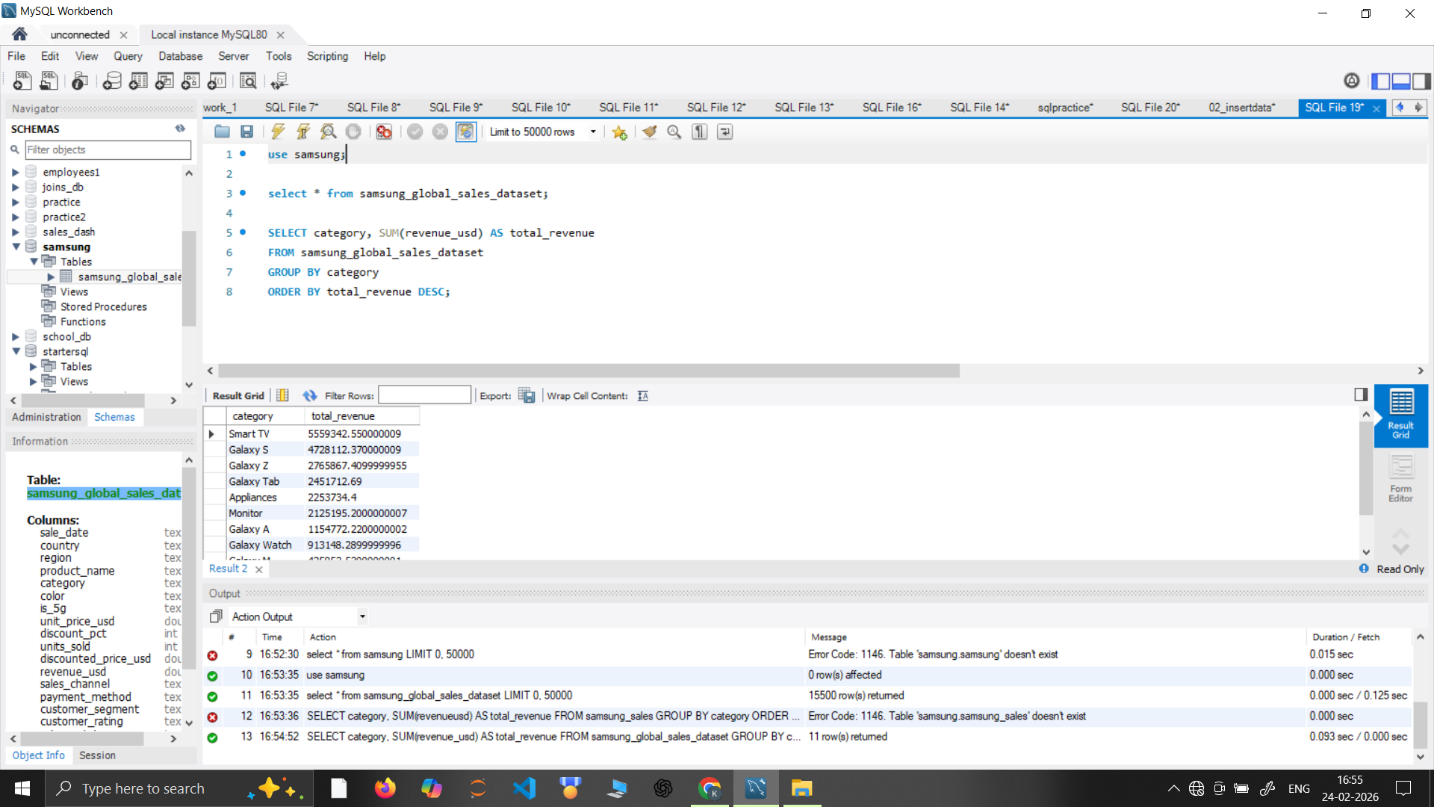
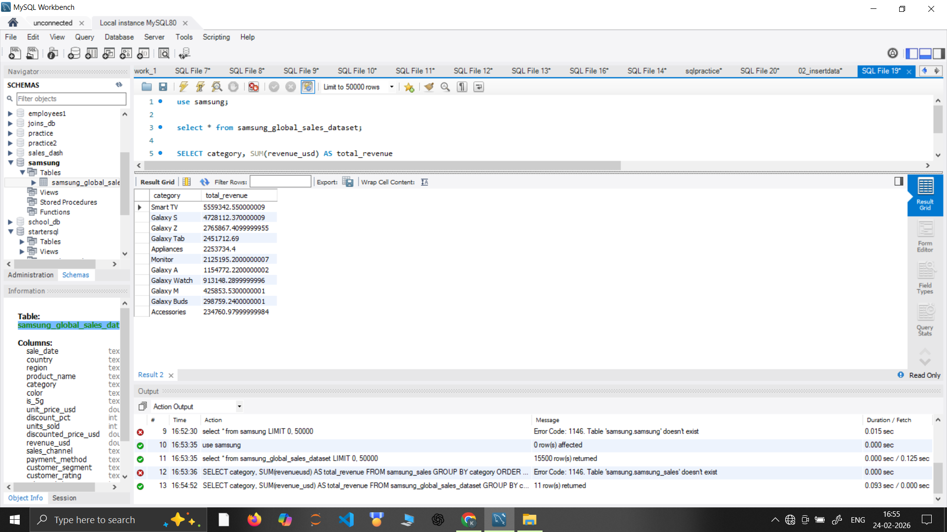
12 Core Business Analytical Questions :
1. Total revenue by category?

Slide 15
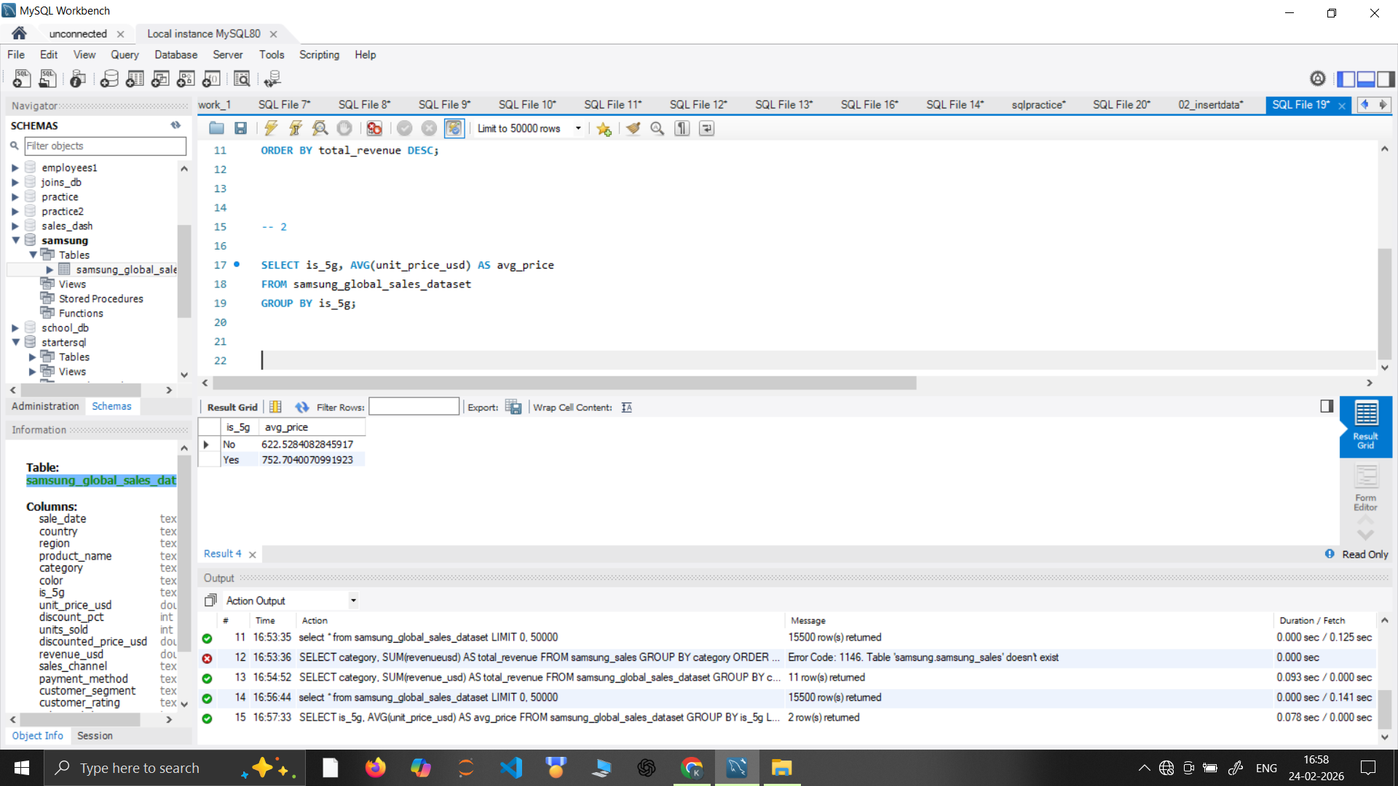
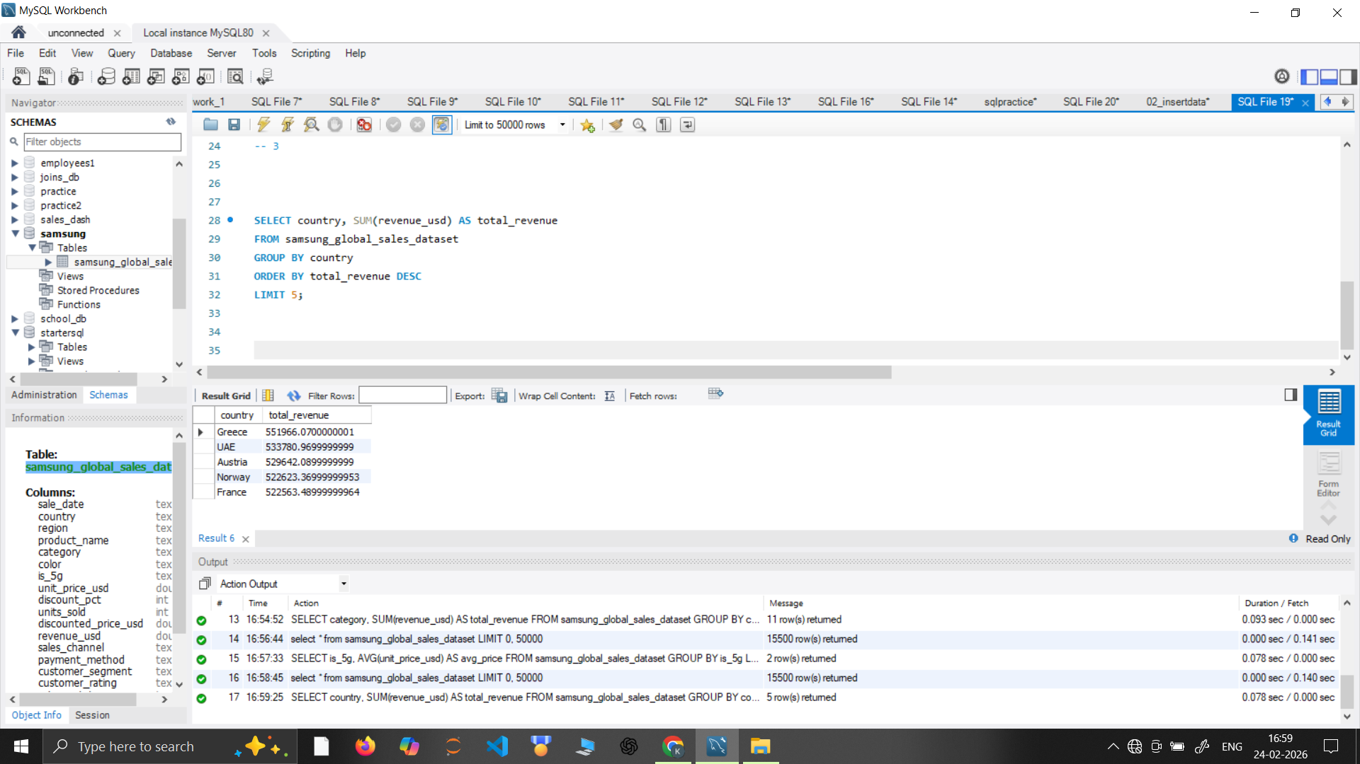
2. Average unit price by 5G status?
3. Revenue by country (top 5)?

Slide 16
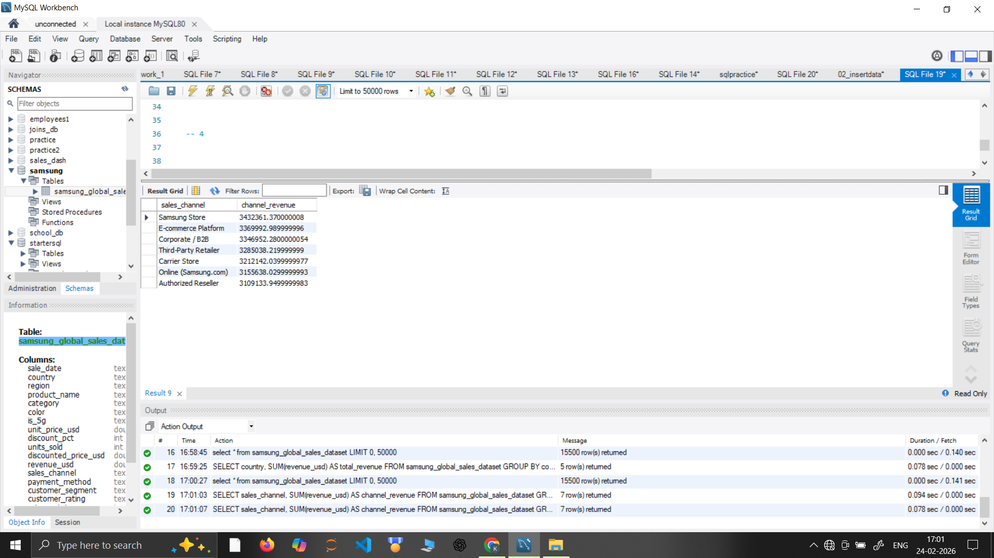
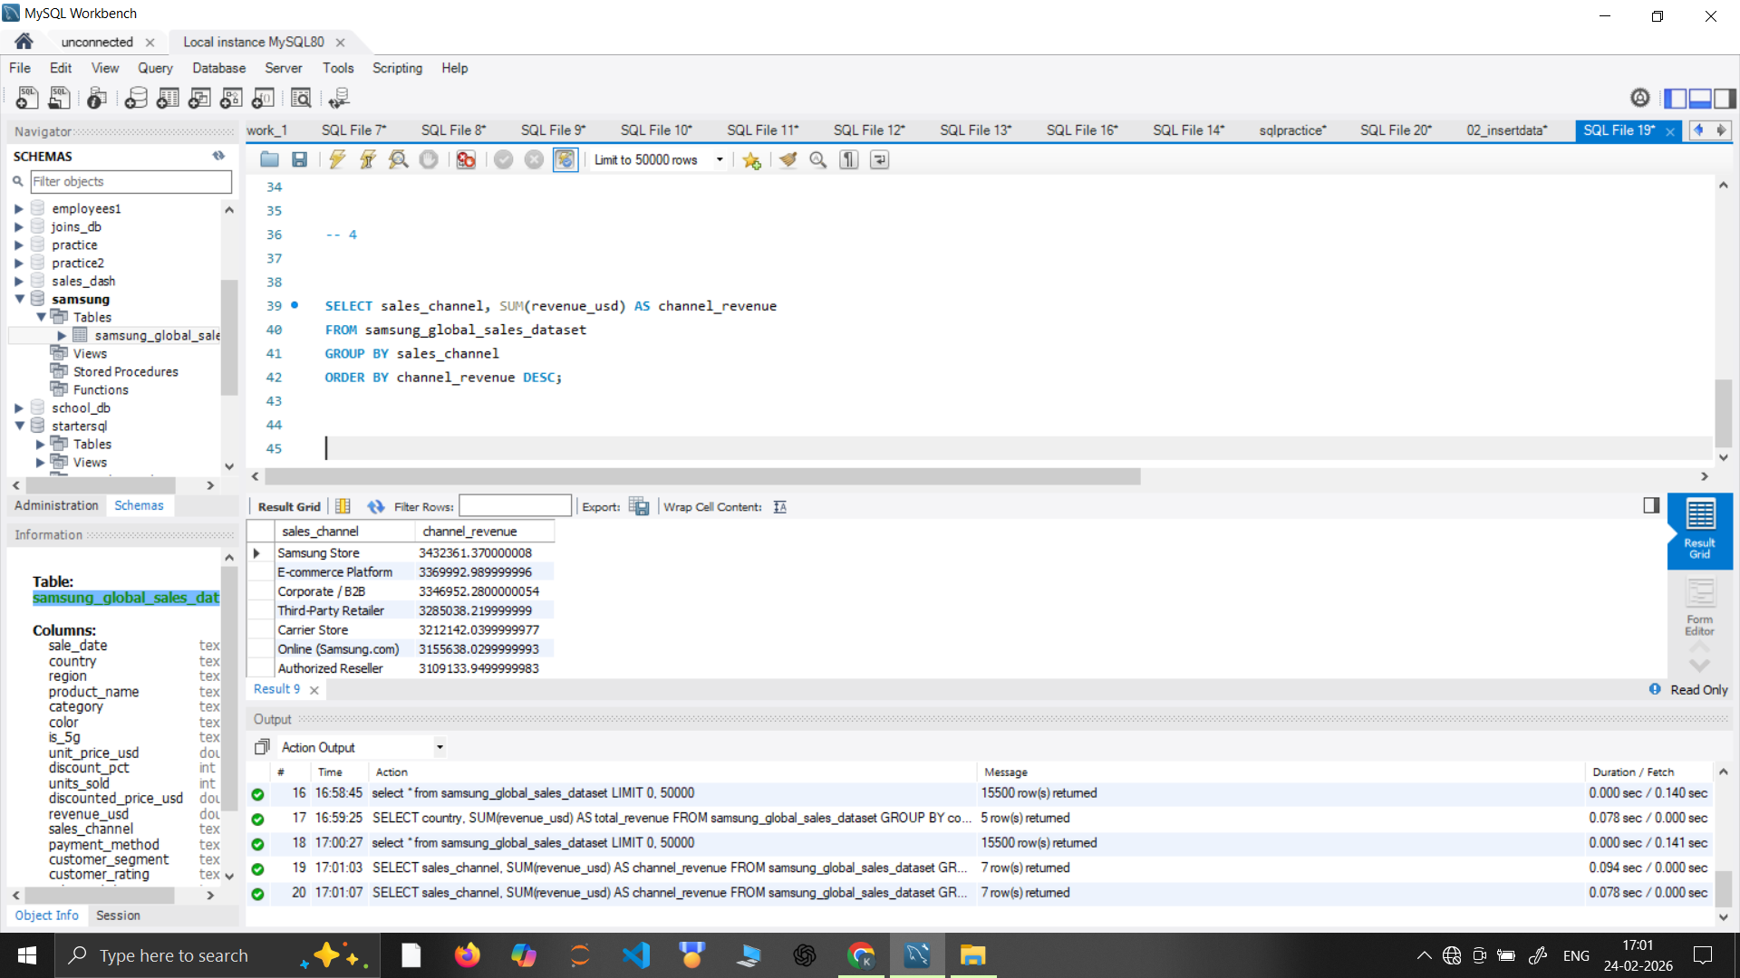
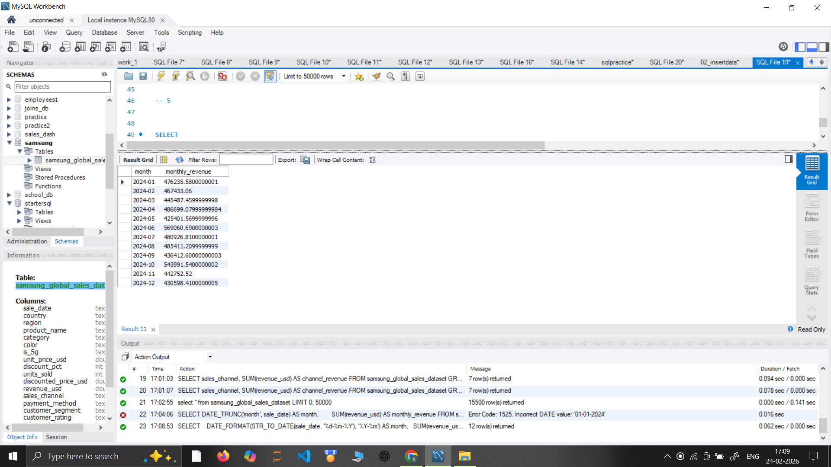
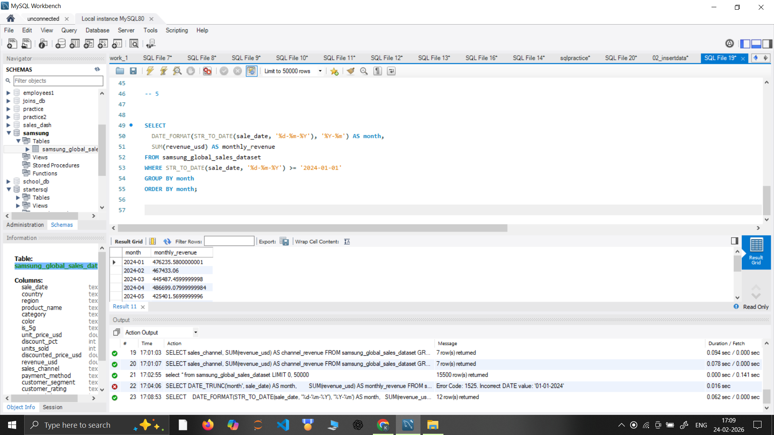
4. Sales channel performance by revenue?
5. Monthly revenue trend (last 2 years)?

Slide 17
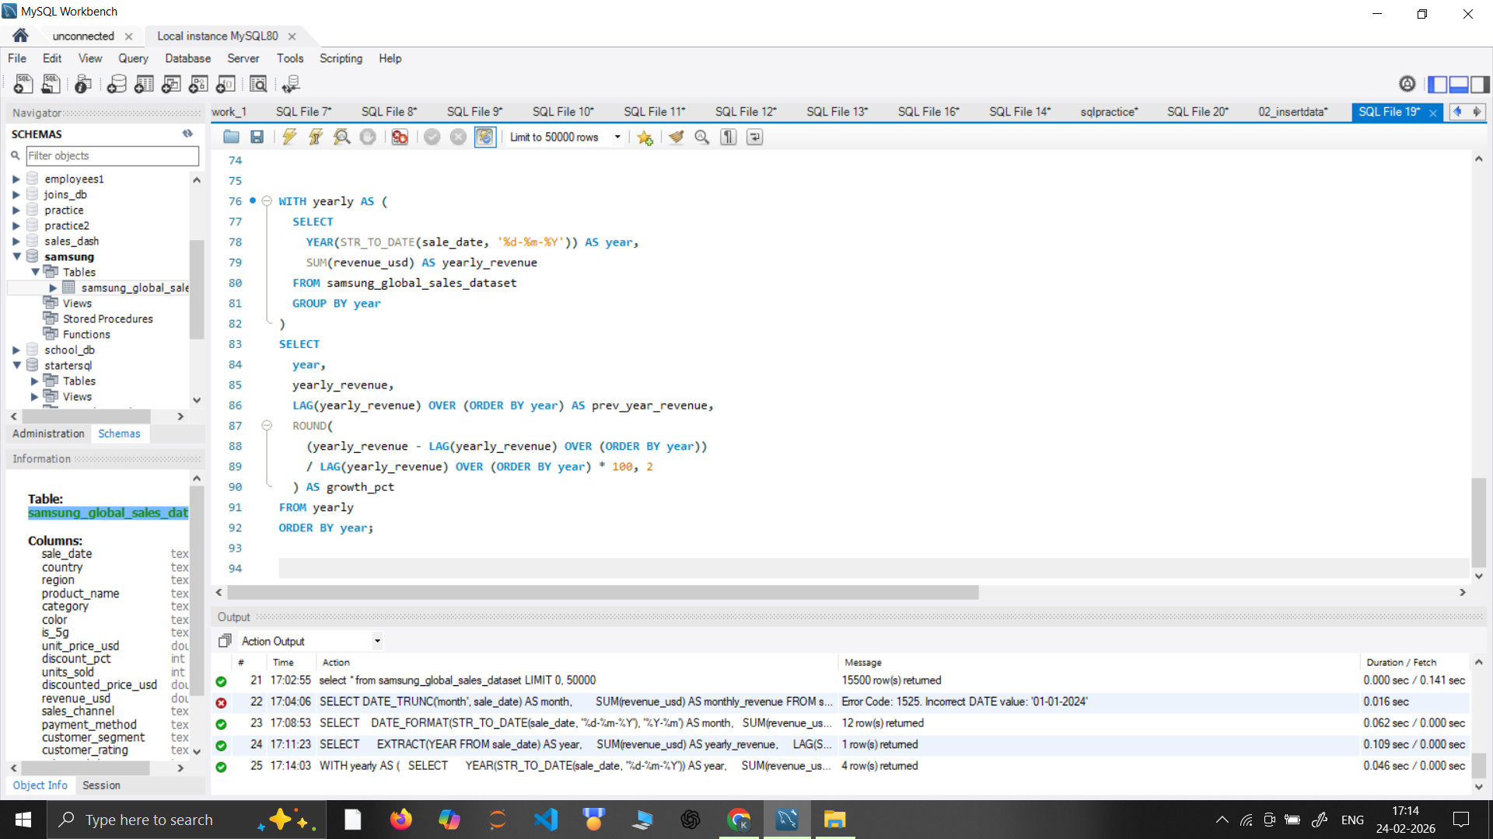
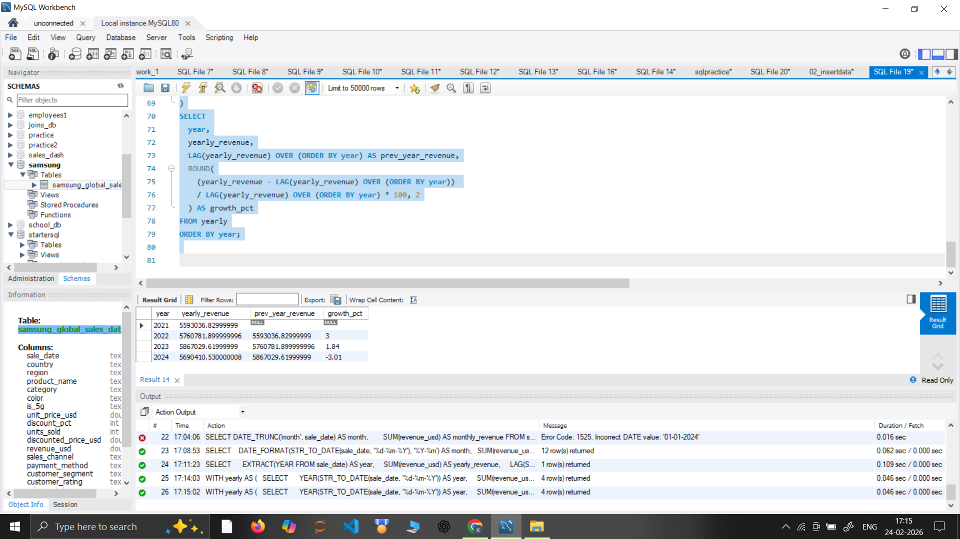
6. Year-over-year revenue growth?

Slide 18
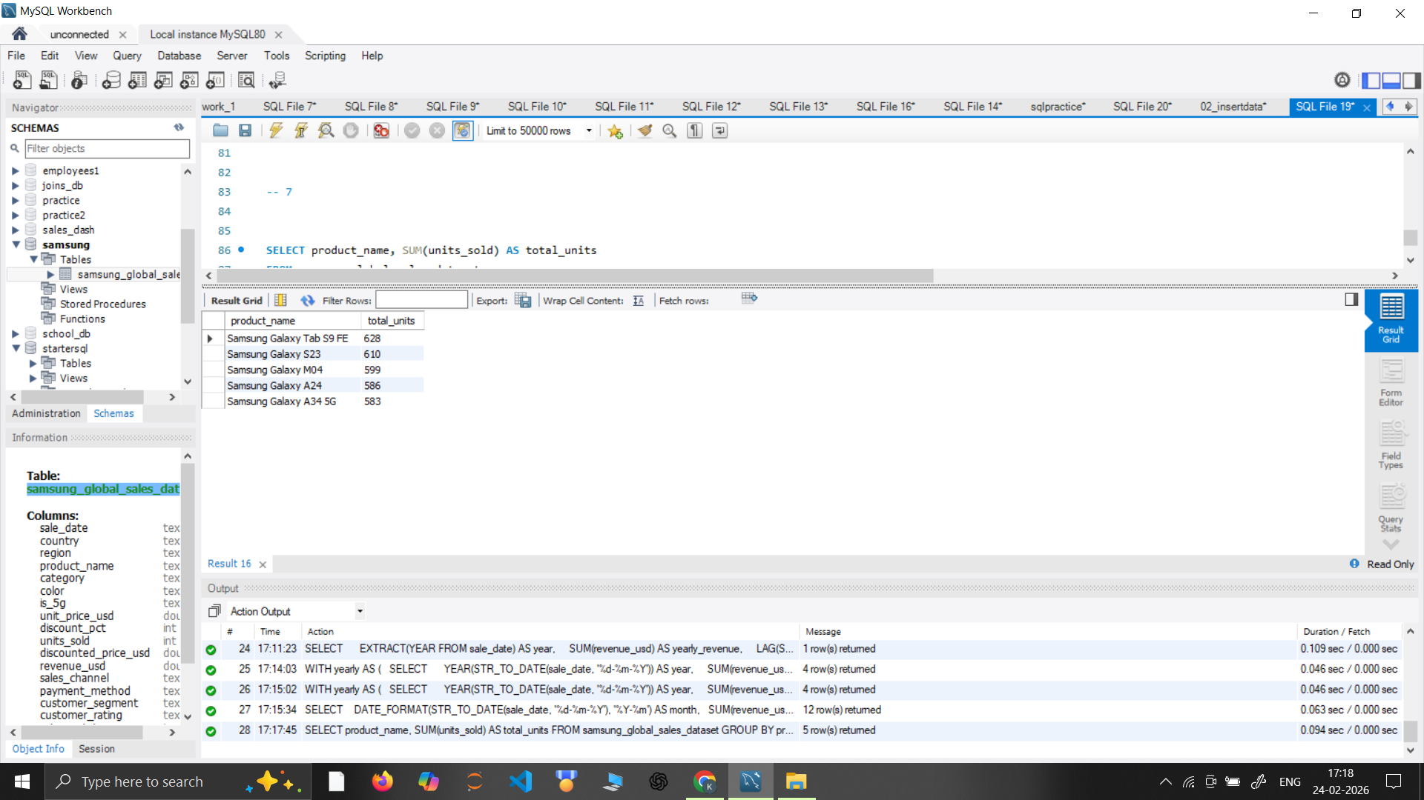
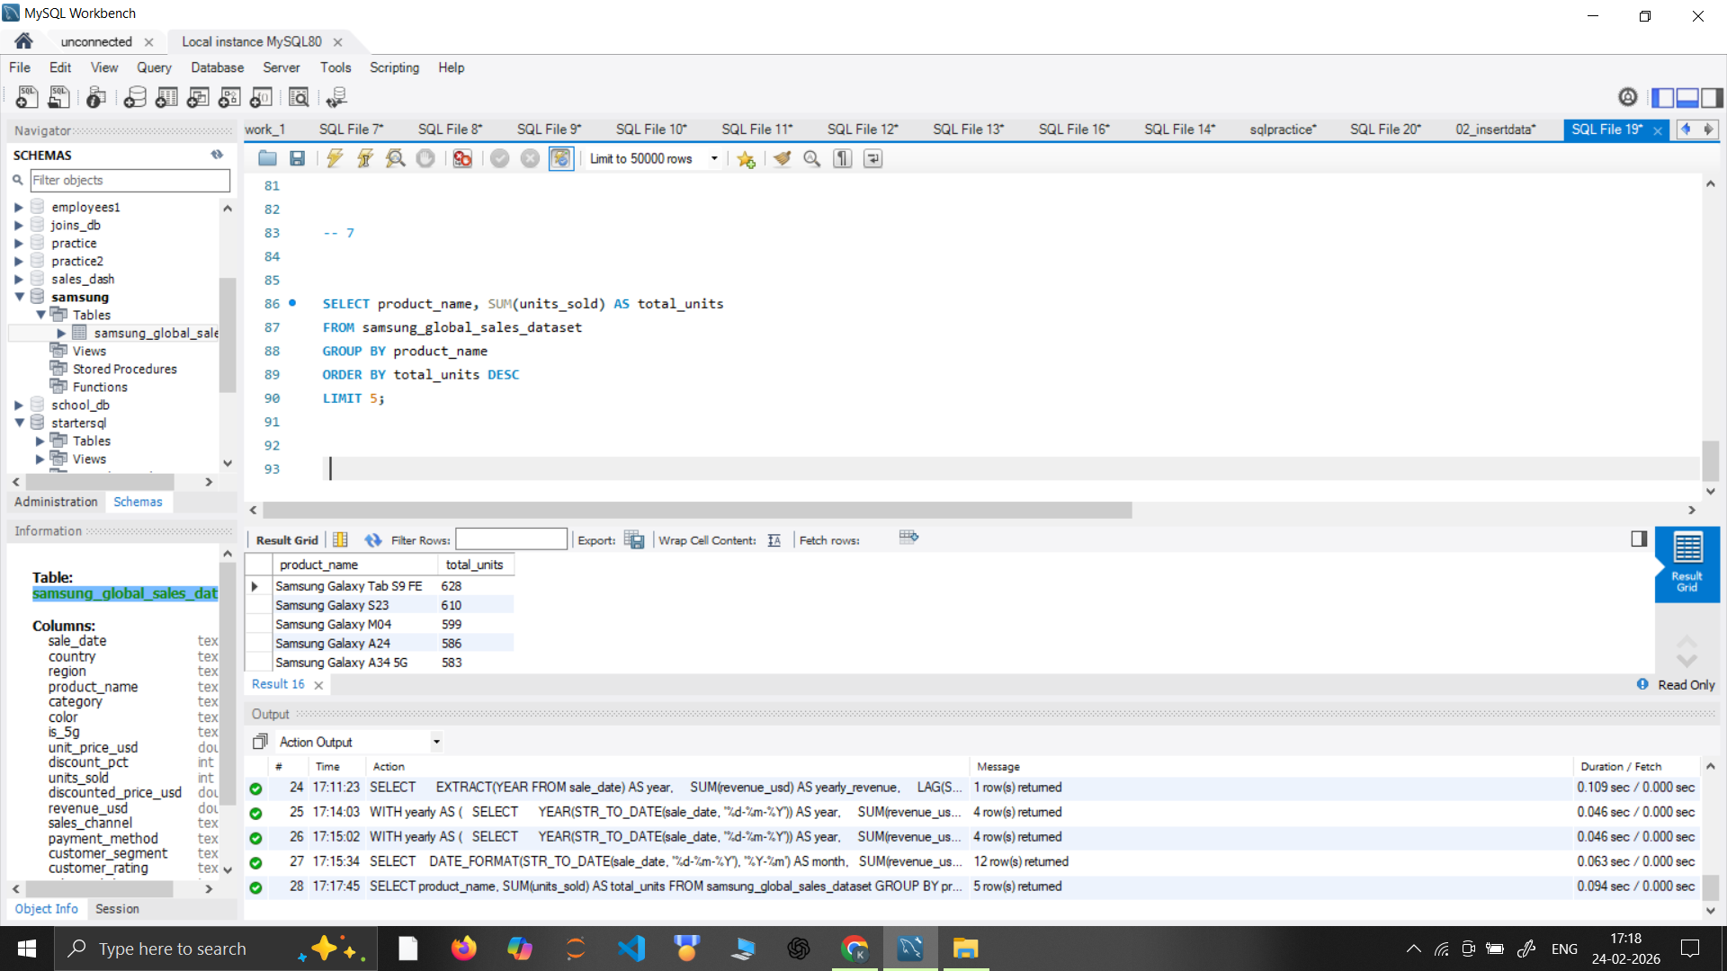
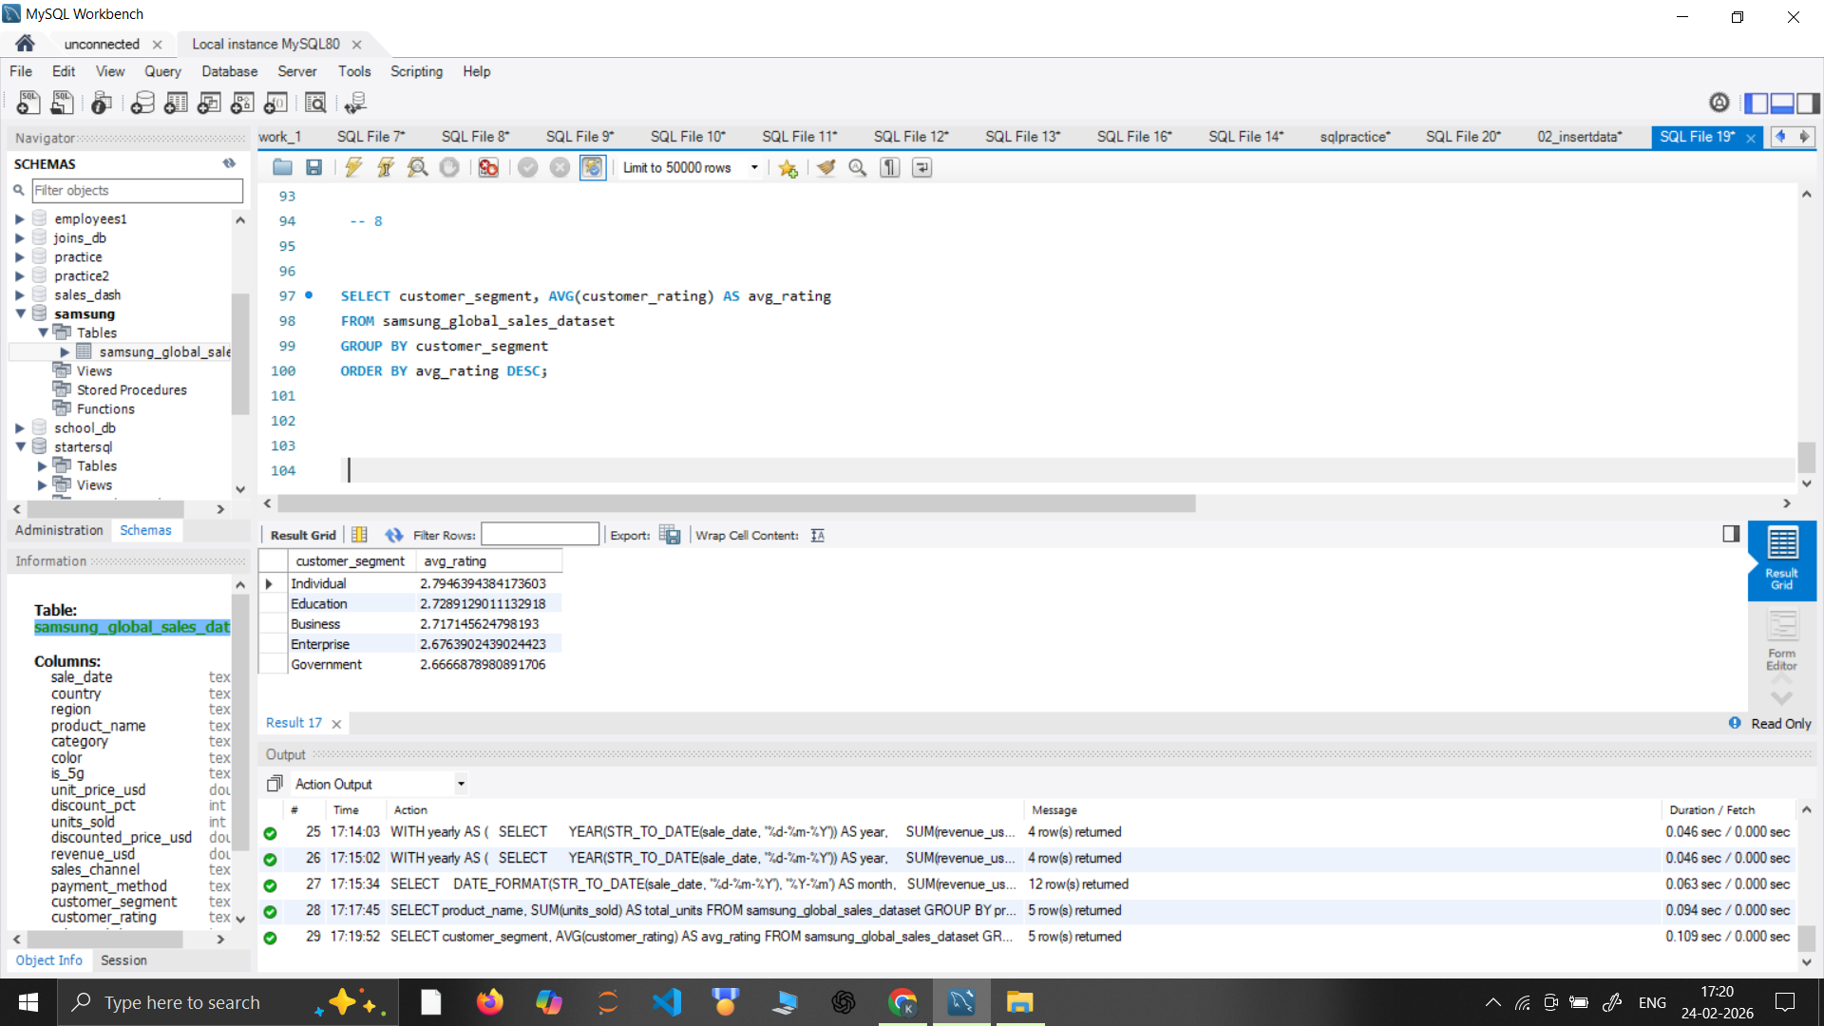

7. Top 5 products by units sold?
8. Customer segment with highest average rating?

Slide 19
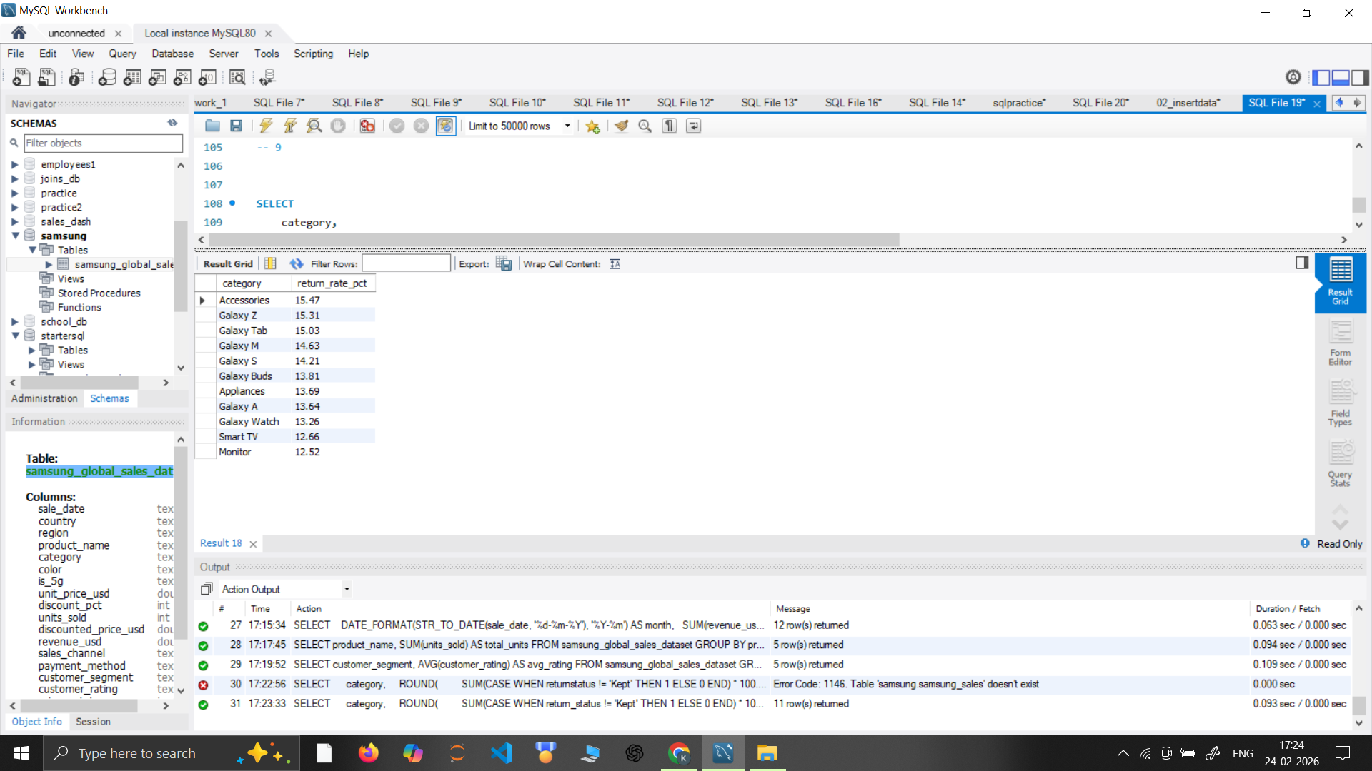
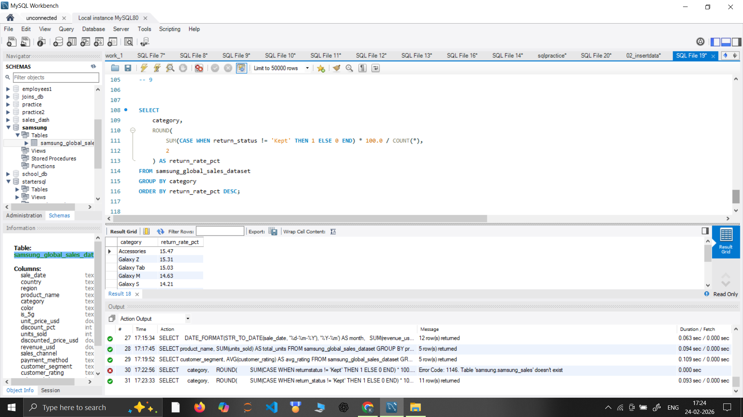
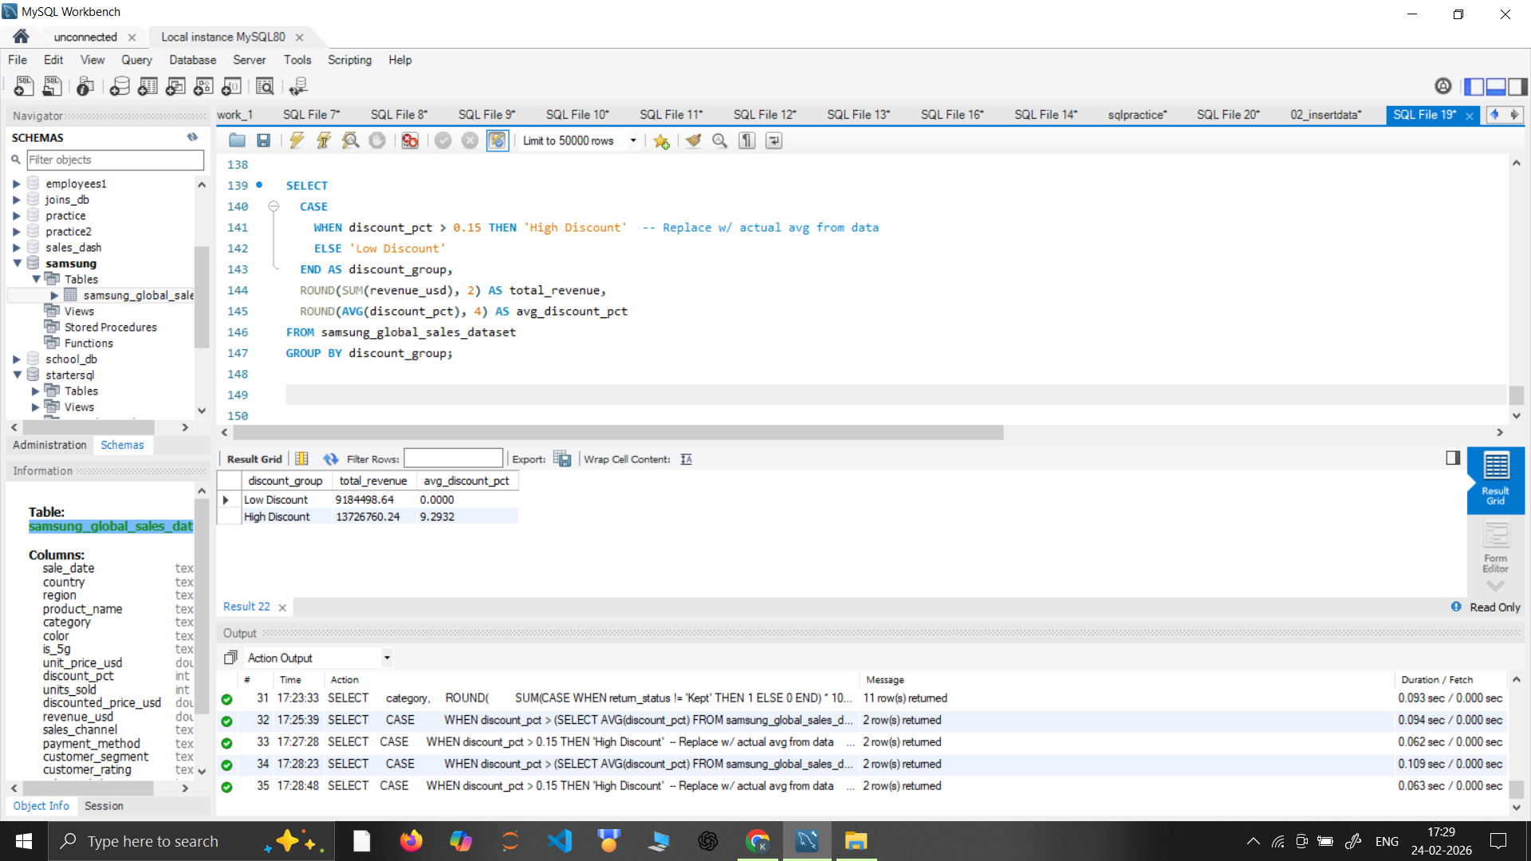
9. Return rate by category?
10. Discount impact on revenue (high vs low discount)?

Slide 20
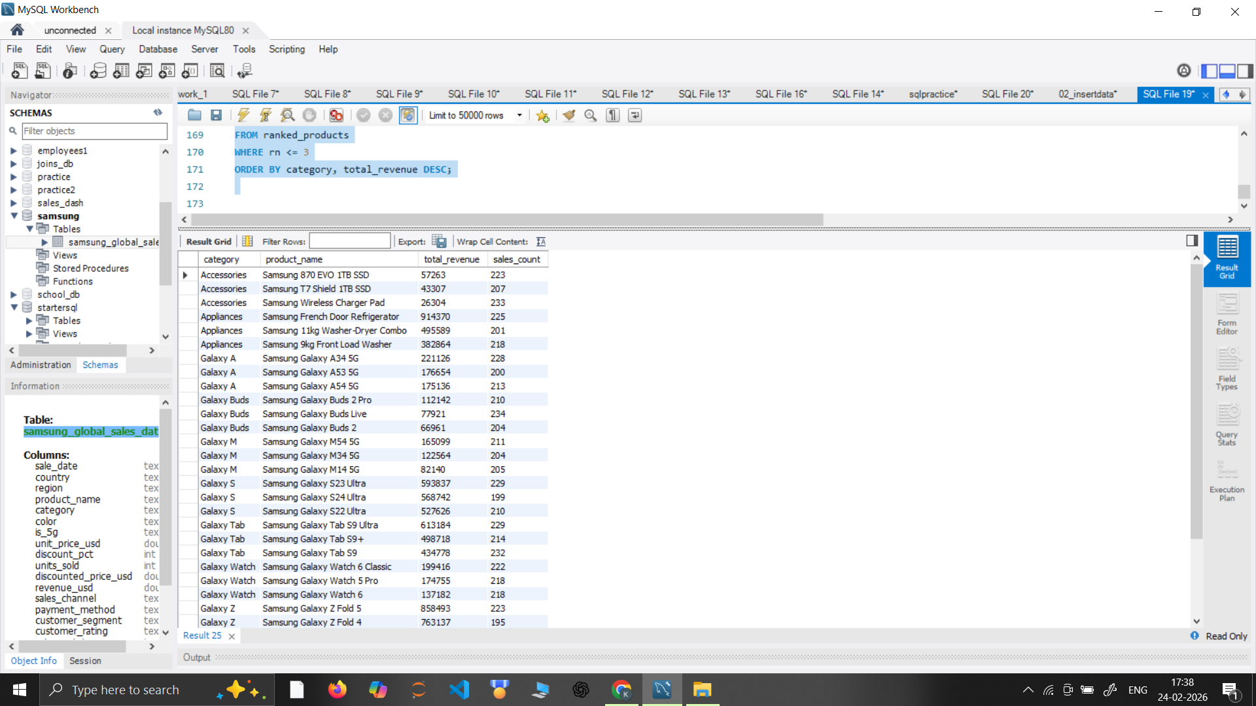
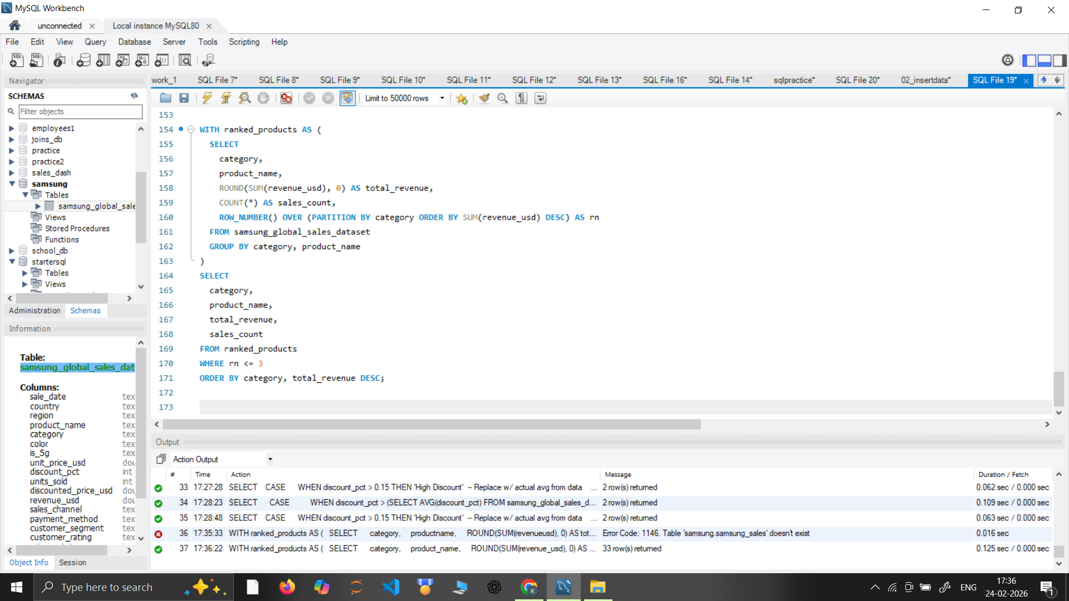
11. Top 3 Products by Revenue per Category

Slide 21
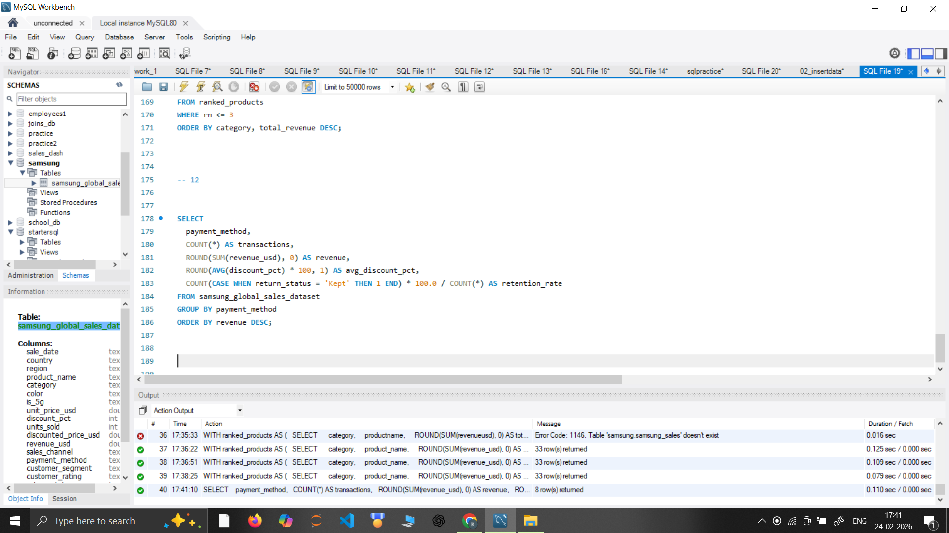
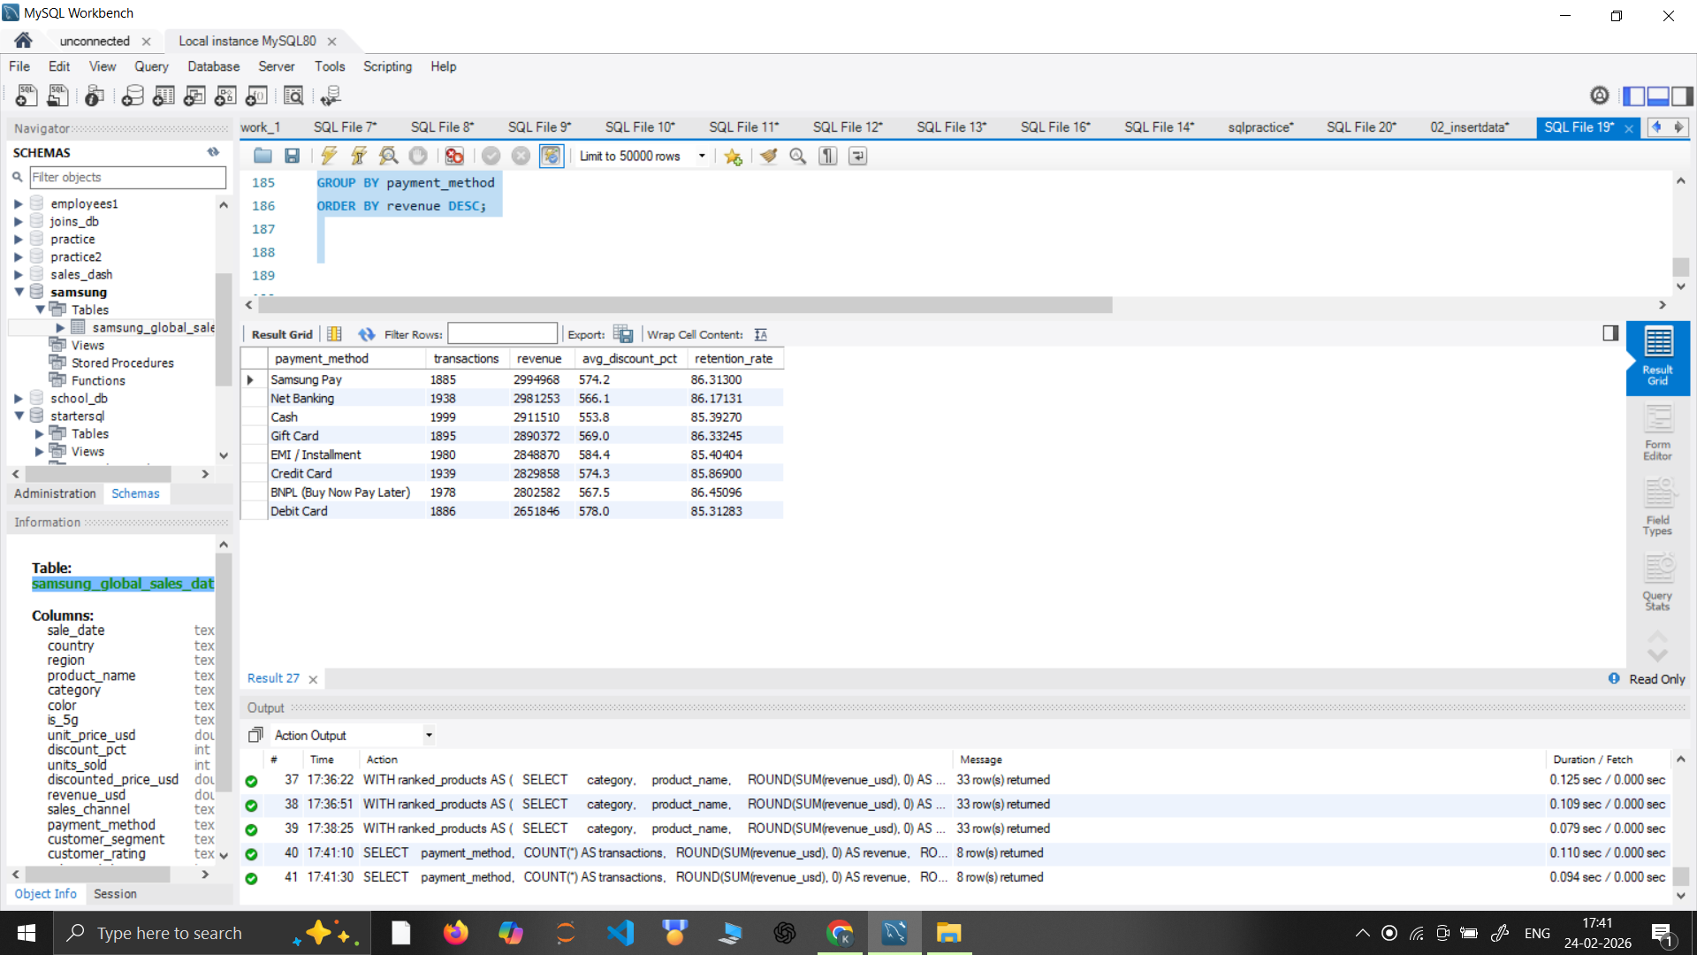
12. Payment Method Performance Dashboard

Slide 22
4 Final Insights :
1. Regional Powerhouse: Europe is the Leader After analyzing 52 countries, Europe is clearly the most profitable region. It doesn't just sell the most; it sells the most expensive items (Smart TVs and Flagship phones).
Action: We should focus our biggest marketing budgets here to keep this momentum.
2. Strategic Anchor: Smart TVs Drive the Ecosystem While we sell many different things, Smart TVs are the "Anchor" of the business. They bring in the highest total revenue ($5.5M).
Action: We should use Smart TV sales to "cross-sell" other products, like Soundbars or Accessories, to those same customers.
3. Technology Shift: 5G Adoption is Growing Currently, 32.7% of our mobile sales are 5G-enabled. While this is good, it means almost 70% of our customers are still on older technology.
Action: There is a huge opportunity to "upgrade" these customers to 5G models in the next two years.
4. Operational Warning: Managing the 7% Return Rate Our global return rate is sitting at 7%. While this isn't a disaster, it is "leaking" profit.
Action: By using the Decomposition Tree, we found specific regions where returns are higher. Fixing the shipping or quality issues in those specific spots could save the company millions.

Slide 23
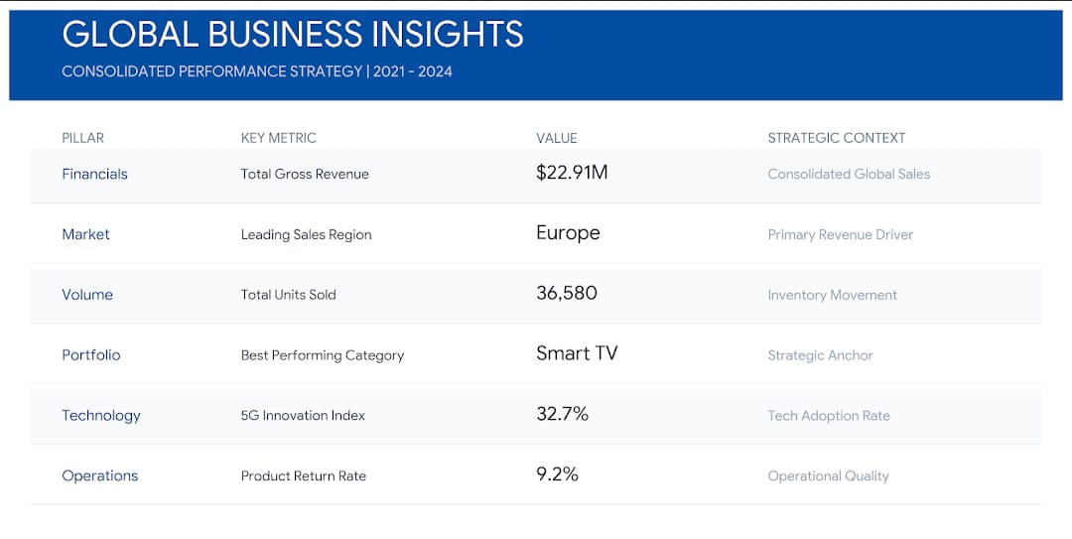

Slide 24
CONCLUSION
This project successfully analyzed $22.9M in global sales, proving that Samsung’s revenue is driven by a "premium-first" strategy. By building a professional Star Schema in Power BI, I identified that Europe is the top-performing market and Smart TVs are the primary revenue anchor. While the business is stable, there is a clear opportunity to convert the remaining 67% of non-5G users to newer technology.

Slide 25
RECOMMENDATIONS
Drive 5G Upgrades: Launch "Trade-in" campaigns to move the 67% of customers still on 4G over to new 5G models.
Fix Product Returns: Use the Decomposition Tree to target the regions causing our 7% return rate and fix the specific shipping or quality issues there.
Shift to Online Sales: Invest more in the Samsung.com store, as online sales show higher profit margins than third-party retail stores.
Bundle Accessories: Increase the "Attachment Rate" by bundling Galaxy Buds or Watches with every flagship phone sale in Europe.

Slide 26
To Reach Us On GIT HUB:
https://github.com/kalashsharma9
https://github.com/sourabharya2002-svg
www.linkedin.com/in/ kalash-sharma-713417392
www.linkedin.com/in/sourabh-arya-246401384/
To Reach Us On LINKED IN:

Slide 27
THANK YOU!

